Slide 1



POTHOLE DETECTION
Guided by : Dr C Punitha Devi
Team Members : MOHAMMAD RAFIYUDHEEN E M

Slide 2

1
Abstract
2
Proposed Solution
Contents
3
Architecture
Merits of proposed
solution
4
5
Algorithm used
6
Conclusion

Slide 3

WHAT IS DEEP LEARNING
Deep learning is a subset of machine learning in artificial intelligence (AI) that has networks capable of learning unsupervised from data that is unstructured or unlabeled. Also known as deep neural learning or deep neural network.

Slide 4
Abstract
The project will provides the details about the potholes in the roads are sensed by the cameras which is placed in the front end of the vehicle. So that it can sense over a wide angle, the sensed data is send to the software application so that it can analyses the potholes with the various size and density which are in the road the fetched data is processed with the current longitude and latitude through the GPS in the vehicle.
I have been using disparity map algorithm techique and CNN algorithm(Train dataset) to detect the potholes, According to the data set the Google map is updated with the various color dots. The orange color dots refers the potholes in the road. So the map has to provide an alternative optimal path to the destination is made and traces the path in the map.

Slide 5

EXISTING Solution
Pothole Detection using PIC 16F877A Microcontroller, Ultrasonic Sensors HC-SR04, GPS Receiver and GSM SIM 900.
Pothole Detection using decision tree Algorithm. 80% efficiency
Pothole Detection using K-MEANS CLUSTERING Algorithm. 73% efficiency

Slide 6


Proposed Solution
The project will provides the details about the potholes in the roads are sensed by the stereo camera which is placed in the front end of the vehicle. So that it can sense over an wide angle, the sensed data is send to the software application so that it can analyze the potholes with the various size and density which are in the road the fetched data is processed with the current longitude and latitude through the GPS in the vehicle.

Slide 7
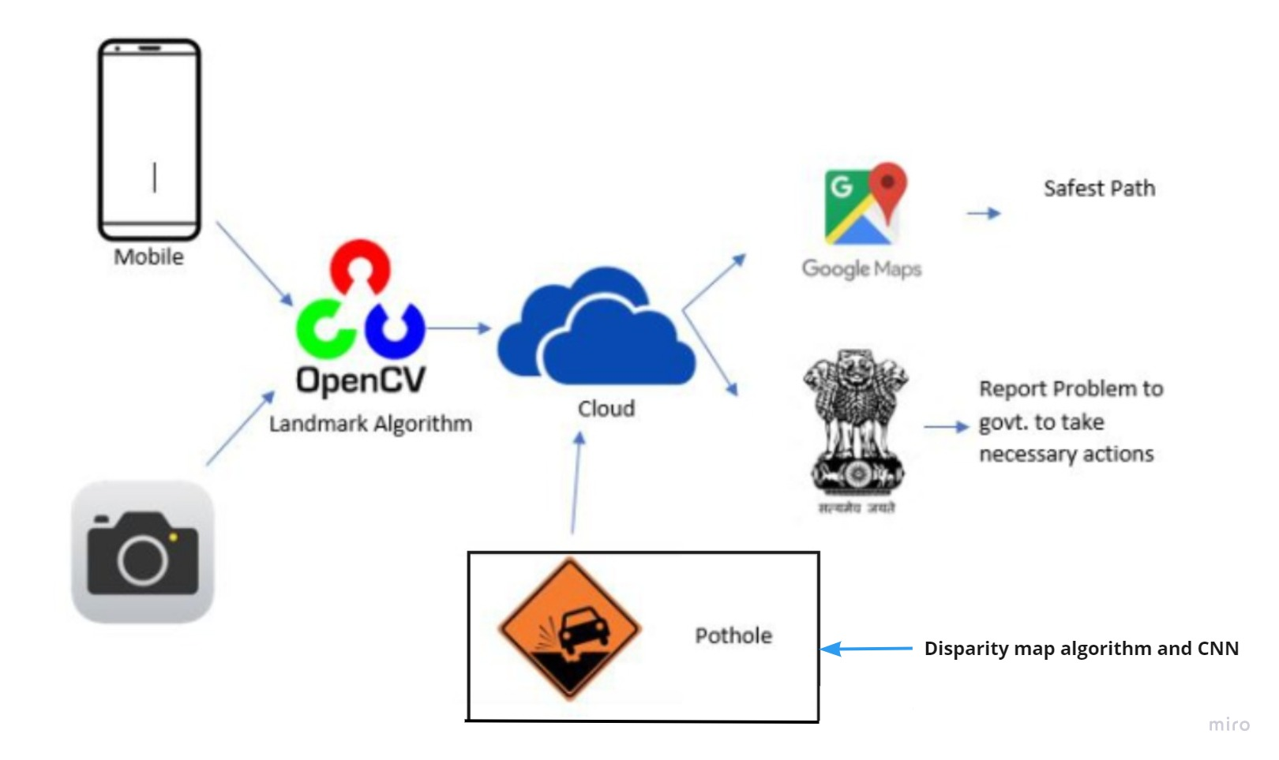
Wrok flow and Architecture

Slide 8
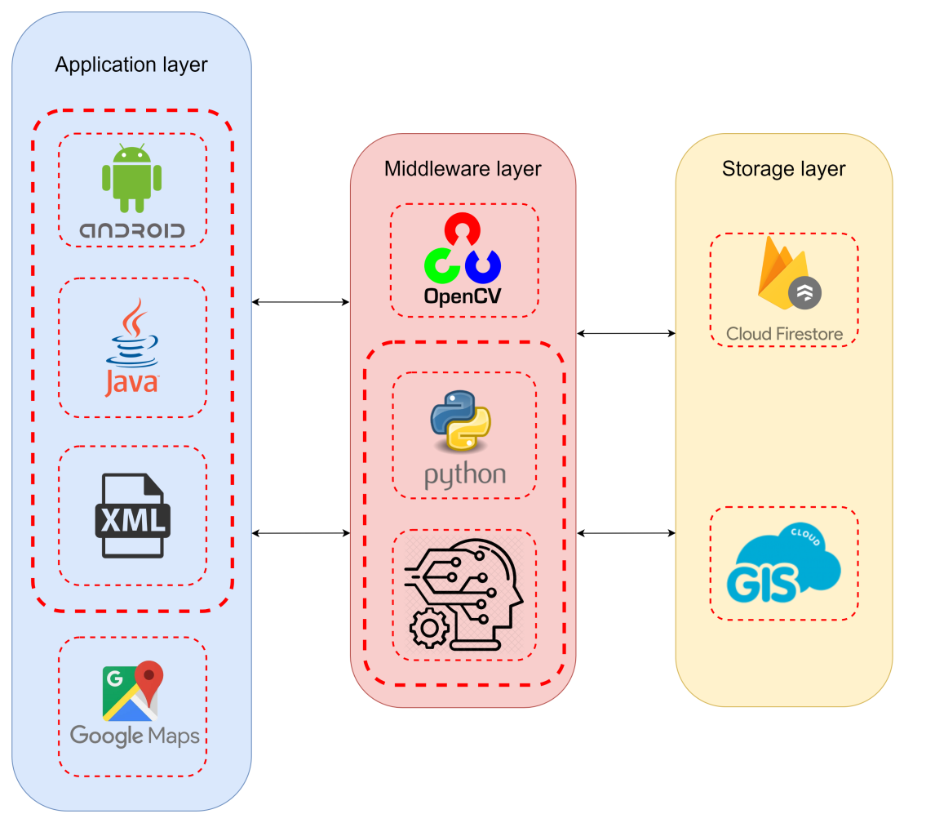

Wrok flow and Architecture

Slide 9





Technology stack
Used to built for Android to accelerate your development and help you build the highest-quality apps for every Android device.
OpenCV is a library of programming functions mainly aimed at real-time computer vision.
Firebase is Google's mobile application development platform that helps you build, improve, and grow your app.
Google Maps is a web mapping service developed by Google.
GIS Cloud is a collaborative mapping platform for real-time data visualization.

Slide 10
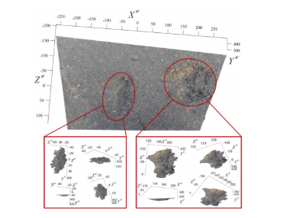
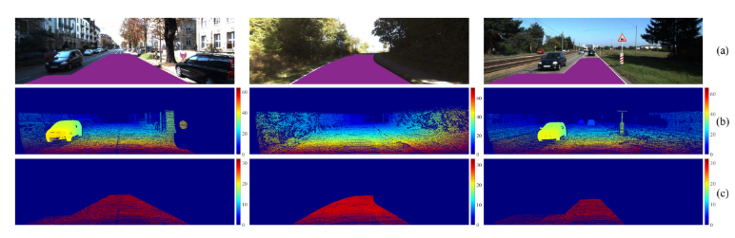
Algorithm Used
disparity map Algorithm:(Technique)
A disparity map, often referred to as a depth map, is an image which contains depth information of every pixel stored in it. The term disparity in stereo vision refers to the apparent shift in pixel or motion in a pair of stereo images.

Slide 11
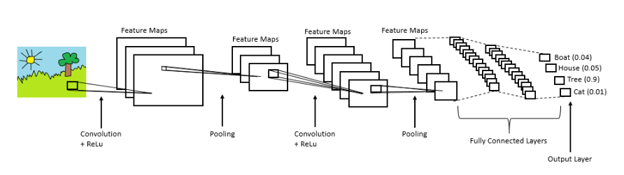
Algorithm Used
Convolutional neural network:
In neural networks, Convolutional neural network (ConvNets or CNNs) is one of the main categories to do images recognition,images classifications.CNN image classifications takes an input image, process it and classify it under certain categories.

Slide 12
Pros Of Proposed Solution
01
Processing the data in cloud makes it much faster and efficient than traditional processing
02
CNNs are a much less flexible model compared to a fully connected network.
03
In disparity map algorithm it makes out the images from stereo cameras thus two cameras are been used one to collect the data set image and other for the 3d image point cloud.

Slide 13
Conclusion
The Pothole Detection System is an attempt to provide its users with better knowledge about the routes of their transportation. We postulate that accurate pothole detection is possible. We believe that our experience will help to improve efficiency and reduce time and effort for further experiments using the Android platform. The conventional image processing techniques provide results that are then insignificant.

Slide 14
Thank You!

